Slide 1
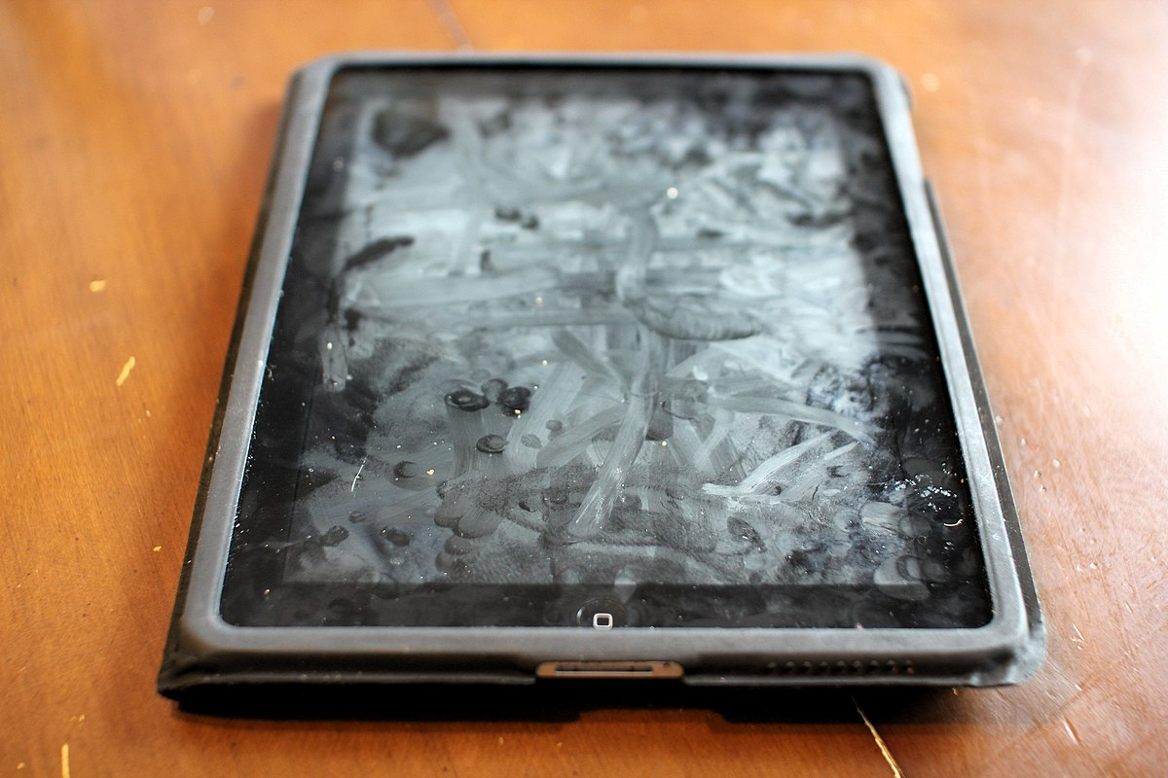
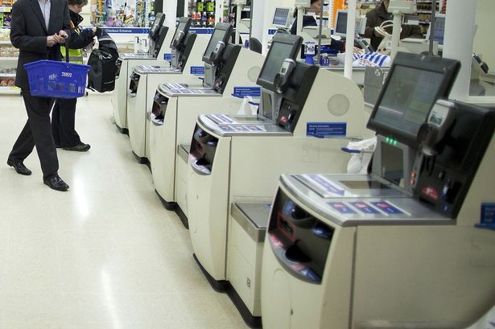

Touchless Kiosks
DEPARTMENT OF COMPUTER SCIENCE
COMP0016, 2022-23, TEAM 37
UCL MotionInput 3.2; Touchless Kiosk Interface for Retailers, Hospitals and Museums..
Team Members:
Aaryaman Sharma aaryaman.sharma.21@ucl.ac.uk
Aryan Agarwal aryan.agarwal.21@ucl.ac.uk
Yidan Zhu yidan.zhu.21@ucl.ac.uk
Clients:
Prof. Dean Mohamedally, UCL
Tom Winstanley, NTTDATA
Prof. Phillippa Chick, Prof. Costas Stylianou, Intel
Notes:
Greetings everyone! We all have probably either seen or used a self-service kiosk at some point in our life. It might have happened in a McDonald's, Tesco, or even a museum.

Slide 2
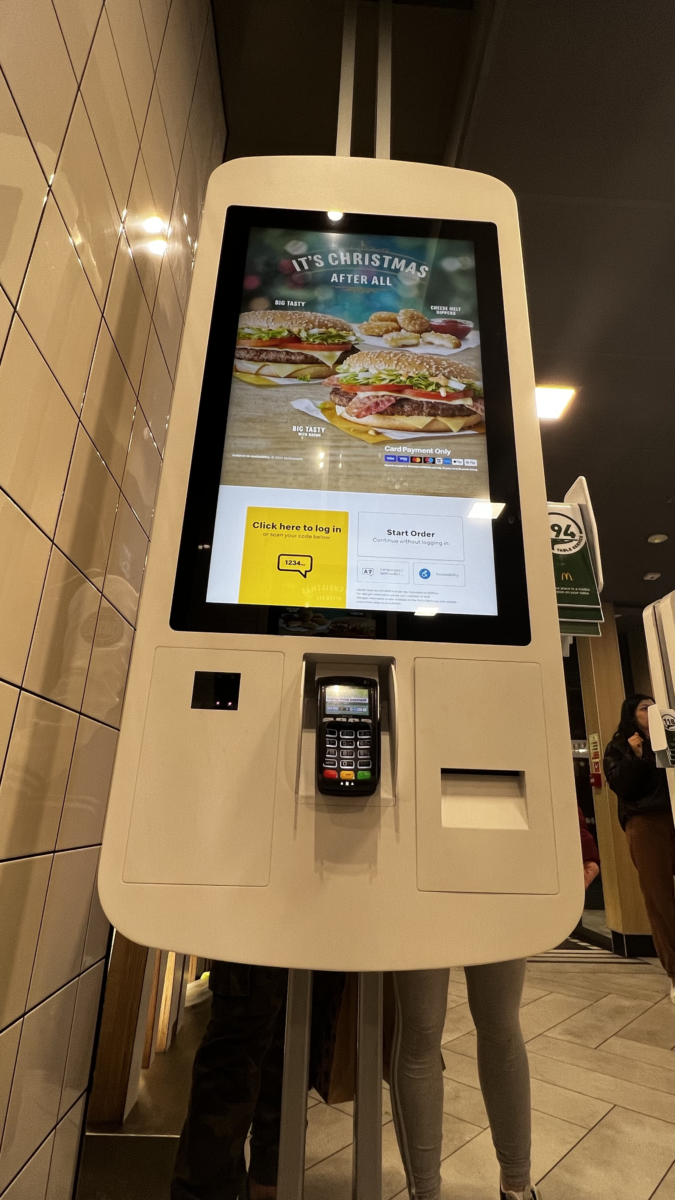

Problems & Solution
How will I use the kiosk?!
TOUCHLESS KIOSKS💡
🧑🏼‍🦽
🤢
Notes:
Despite their importance in our daily lives, they have two major issues- they are extremely unhygienic and a lot of them have accessibility issues.
We are tackling these problems by making kiosks touchless. UCL MotionInput is being used to support additional forms of input such as hand and facial gestures along with speech input. The hygiene issue is immediately solved by adding these, but in order to truly make kiosks accessible, we needed to ensure a flawless user experience.

Slide 3
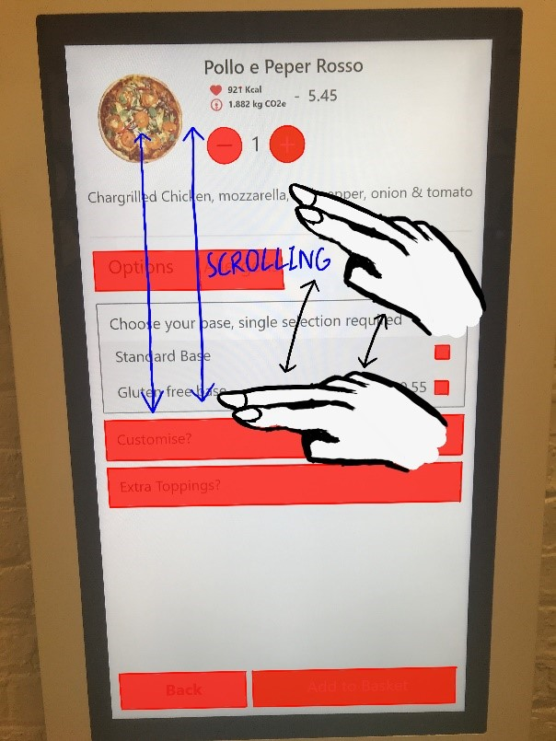
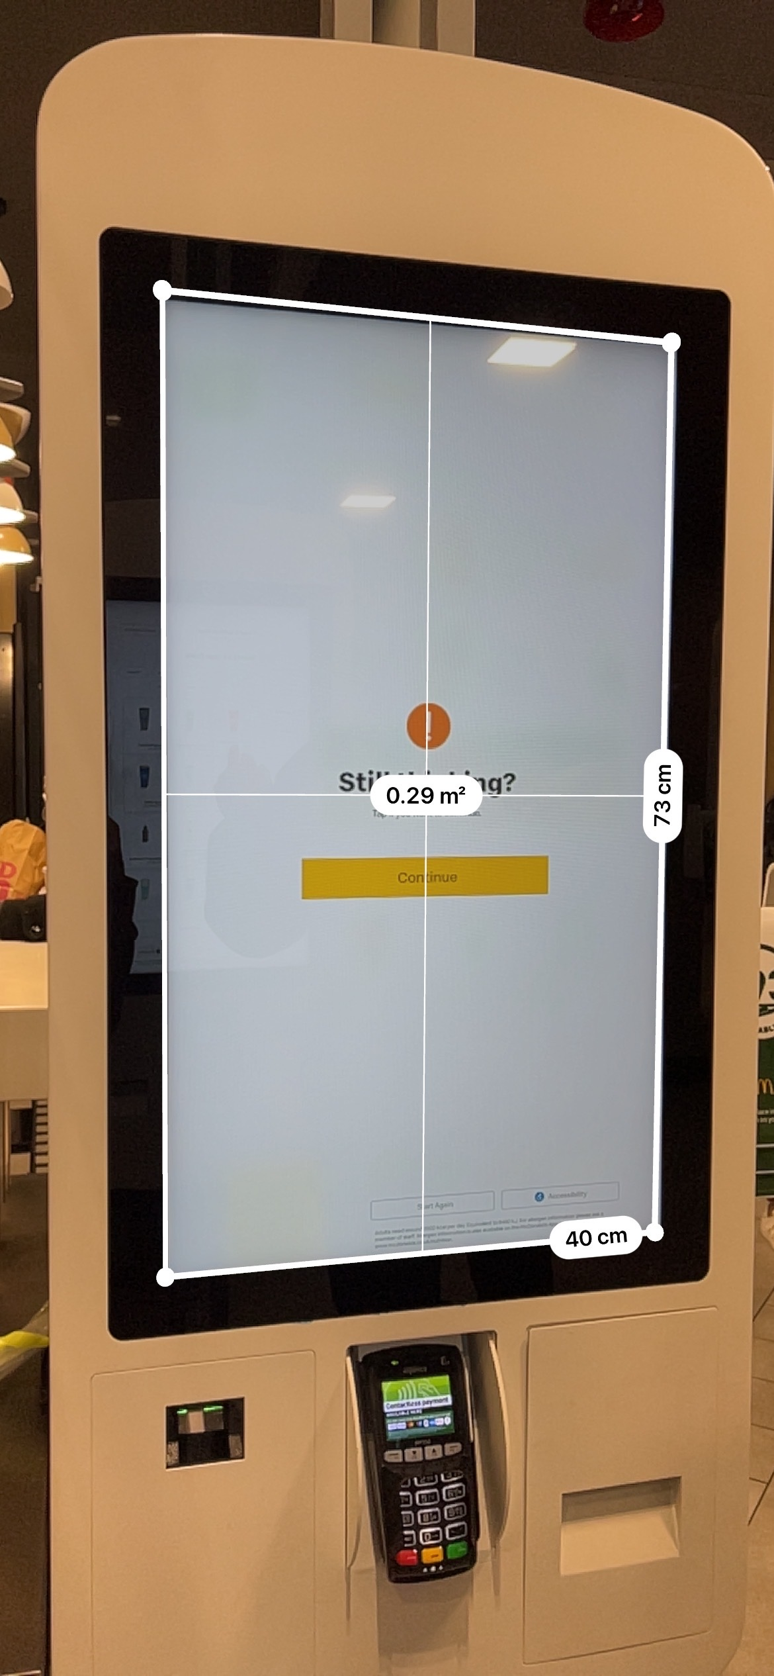
USER EXPERIENCE
Challenges
Resilient UI
- Avoid Small Clickable Zones
- Radial Menus
- Color Blind Adjustments
Minimal Gestures
Switching Modes to Allow Staff Assistance
Notes:
Our team researched the current market kiosks, we observed their UI, dimensions, use cases, etc . We then devised ways to improve the user experience while ensuring the shortest learning curve for operating touchless kiosks.
Such as,
A resilient UI
Minimal gestures
Switching Modes to Allow Staff Assistance, etc

Slide 4
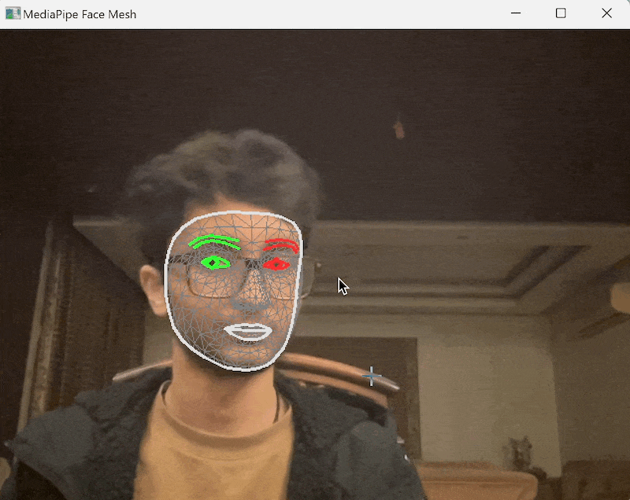
CROWD DETECTION
Challenges
Tracking the Correct User and Ignoring Others
Detect Best Face
on start
Generate Facial ID
Lock on to Face
Validate Facial ID
Lock on to Face
face disappears and appears
Track only the Facial Landmarks
Notes:
There was one more obstacle to overcome: crowd detection. Our kiosks will be used in a public setting with a large crowd. We needed to ensure that we tracked the correct user while ignoring the people in the background. We follow an elegant approach to tackle this problem which ensures both efficiency and accuracy.

Slide 5
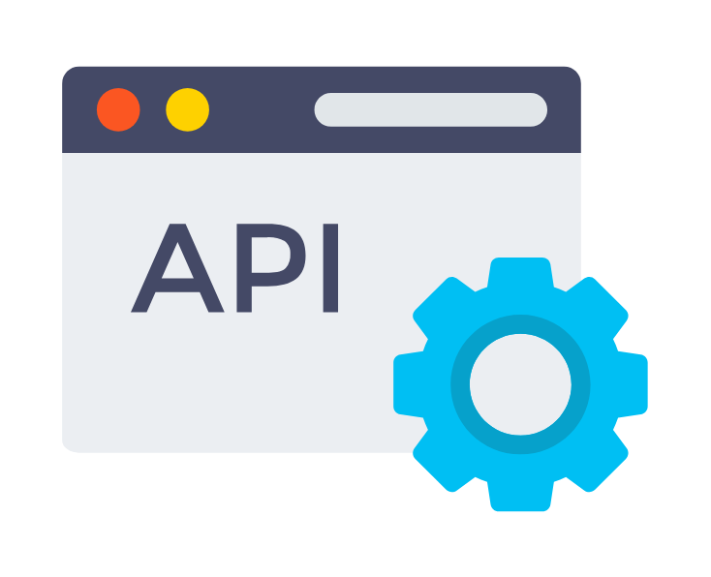


Deliverables
Crowd Detection API
Research Paper on Consistently Resilient Touchless Kiosk Paradigms
Deployment Manual
Report Website: https://touchless-kiosks.webflow.io
Notes:
At the end of this project, our team aims to deliver the following:
A crowd detection api
A Research Paper on Consistently Resilient Touchless Kiosk Paradigms
And A deployment manual
All of which can be used by future developers to extend the functionality, such as, adding speech isolation for speech inputs

